Slide 1
UNILOG PROJECT WORK
Sanket.S.Kulkarni
7th Semester(CSE)
Majari.M
7th Semester(ISE)
Abhishek
7th Semester(ISE)
Vyshnavi
5th Semester(ISE)

Slide 2
Contents
Basics What We learnt
First Presentation in Unilog Company Mysore-Topics
Snap shots of later Implementation
Support
Conclusion
Outcome Of Project

Slide 3
Basics What We learnt
Initially we started working on learning on basics of html, JavaScript, XML.CSS
Learnt on Basics on Game Theory
Tried to Work on R-Language
Worked with Survey Papers
Discussed and started Working With topics such as REST,SOAP
Particularly Specified to work on Implementation Of DOM(Document Object Model)in XML

Slide 4
Discussion Of Topics in Mysore
TWEETER HANDLER COUNTER-TweetCount, TweetButton,Widgets,Twitter API
Game Theory-Mainly I presented this topic where we were was asked to show more Implementation with that respect Our team wrote a program for “Determination Of Saddle Point” in all three Programming Languages C,C++,Java
WEB API-
What Is a Web API?
Routing in Web API
Creating a Web API for an MVC 4 Web Application
RESTful Services

Slide 5
Objectives Prescribed
Take a product add a description to it
Then show the different variants
Take the price of the product
Keep on changing the product values dynamically
Use of database for the entries
Use of R-language as prescribed previously for optimization
Use of web API as a source to products used
Finally the price optimization using cart concepts(add to cart and remove from the cart).
Designed a friendly E-Commerce website

Slide 6
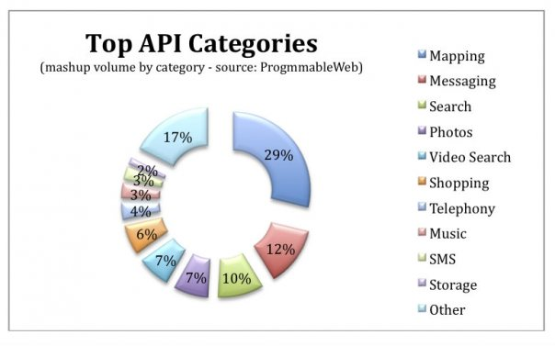
Stats Collected by Team

Slide 7
After Works On Project
Website design works along with responsive product
In this we have worked on designing website which is e-commerce purpose(commercial site)
We have tried to implement a Javascript
Prices of commodities and add to cart taxes etc can be included
We can give a refference addresses and currency rates we have tried
No databases as such is required
we have tried to add an image using srcimg in our commercial website
We have tried implementing for animals similarly possible for any purpose

Slide 8
Website design works along with responsive product
In this we have worked on designing website which is e-commerce purpose(commercial site)
We have tried to implement a Javascript
Prices of commodities and add to cart taxes etc can be included
We can give a refference addresses and currency rates we have tried
No databases as such is required
we have tried to add an image using srcimg in our commercial website
We have tried implementing for animals similarly possible for any purpose

Slide 9
Future of OSS
“Service providers are challenged to cut costs and increase revenues dramatically to achieve profitability with reduced workforce and budget.
Service providers who survive and thrive will be leaders in operational excellence. This means increased automation and streamlined business processes that transcend complex network technologies.
The bottom line: changing from a labor-intensive company to a lean and efficient automated machine and changing from a technology-focused company to a service-focused company.
Streamlined, automated, integrated OSSs are critical tools to achieving operational excellence.” (Donna Bastien, Worldwide OSS Marketing Manager)

Slide 10
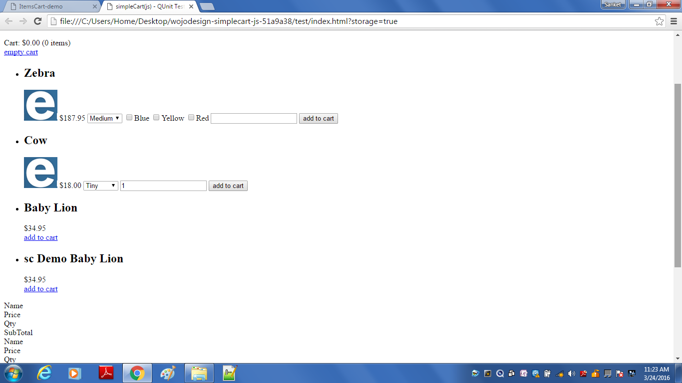
Snap Shots Of Works Done On Implementation as Per Requirements

Slide 11
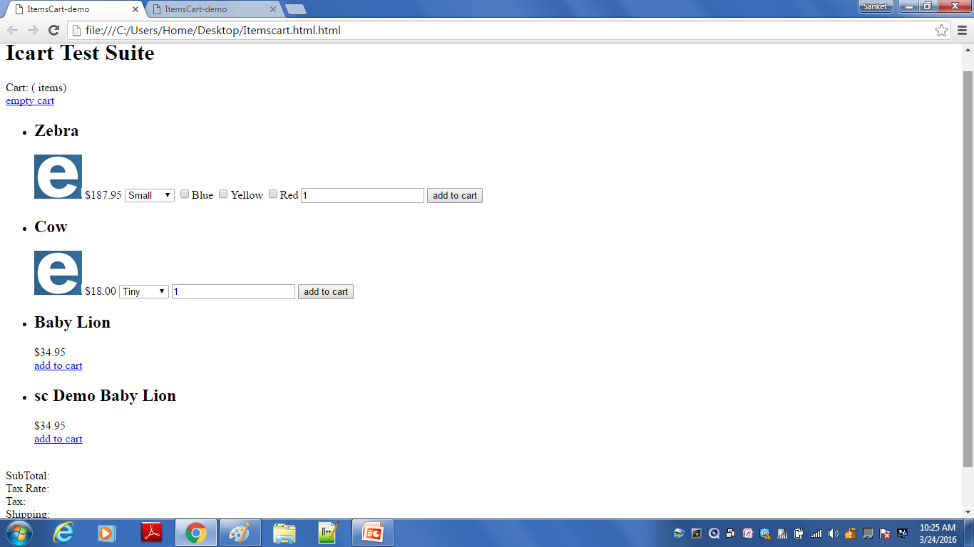
Continuation Of Snap Shots

Slide 13
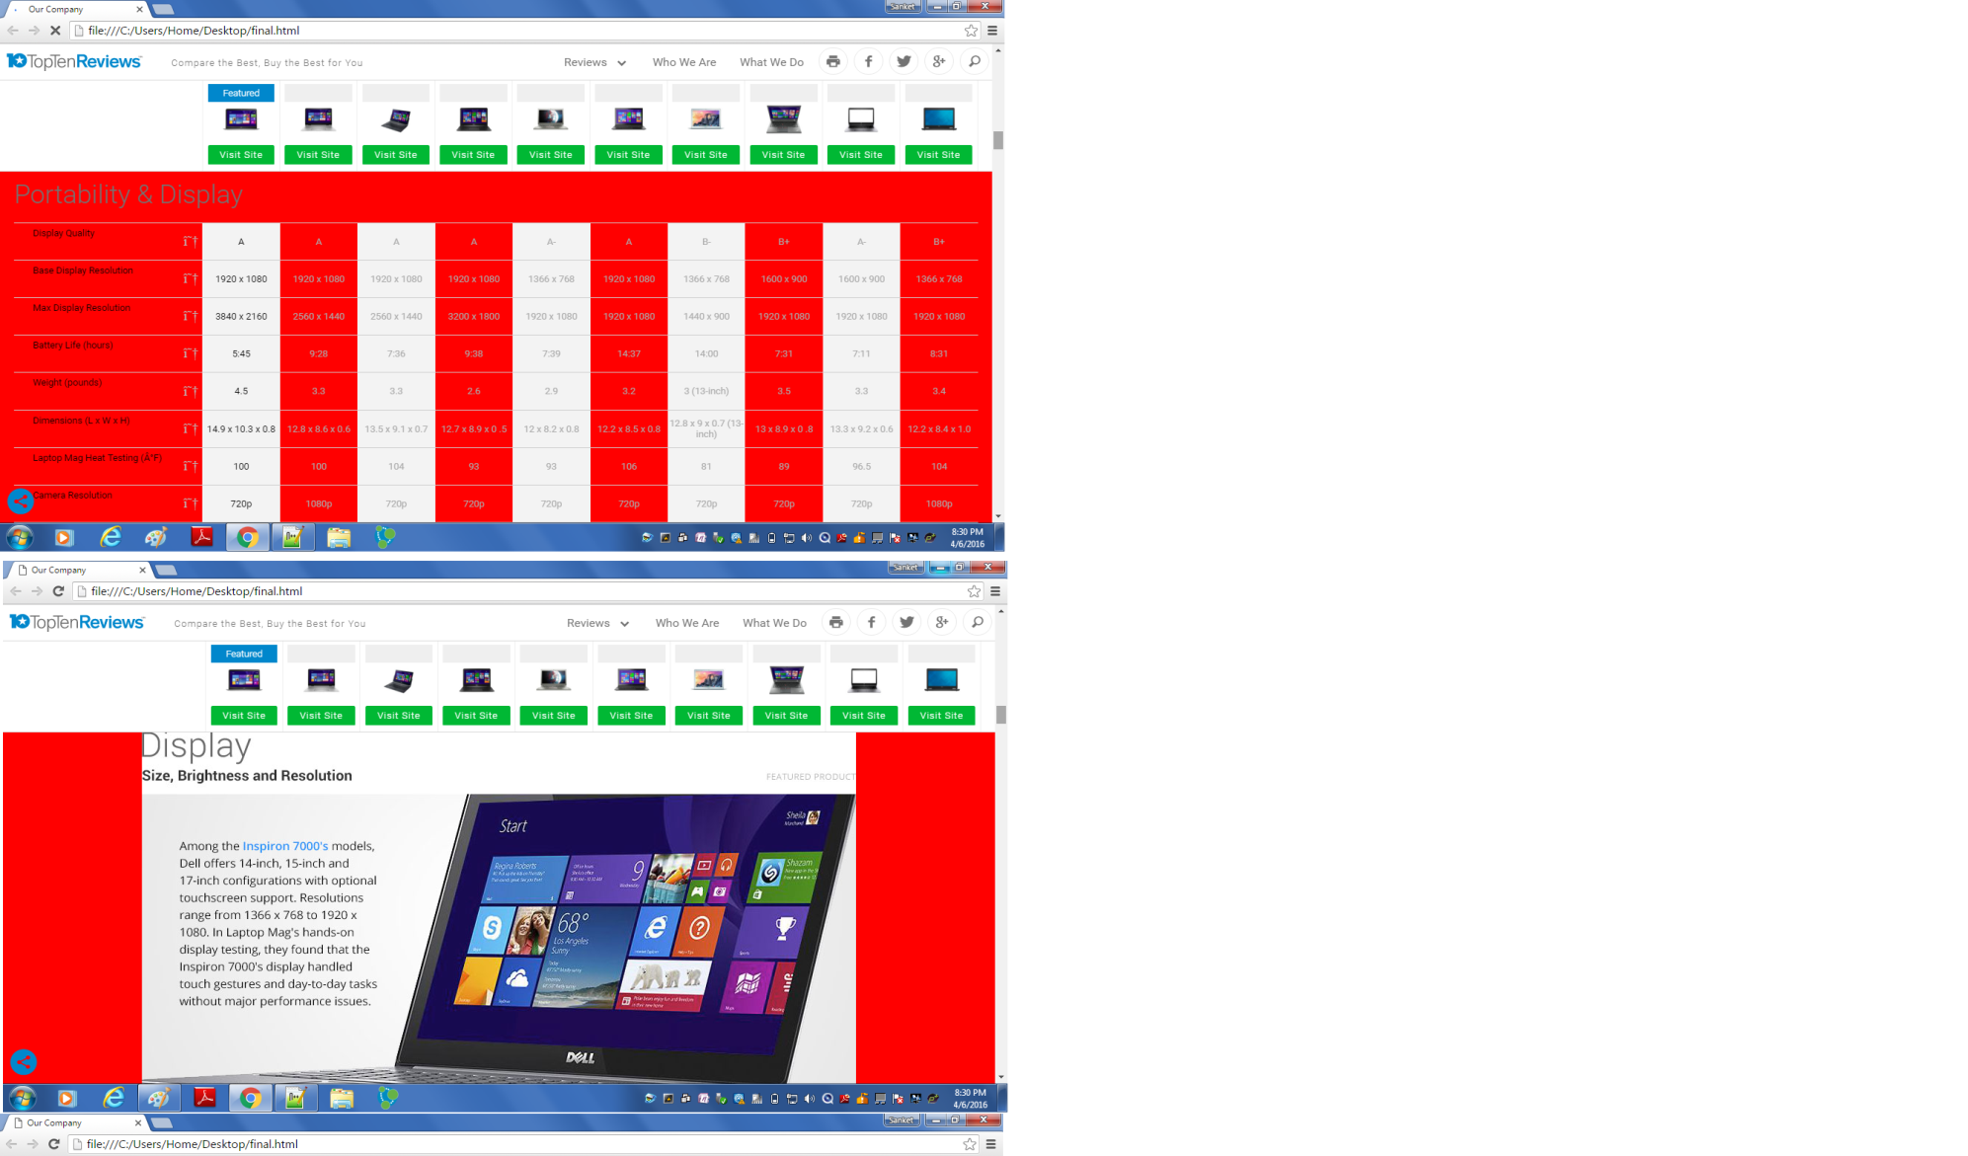
Description Of Each Laptop

Slide 14
Support
We would also like to thank mainly the Unlog Company without which we would have not got an oppurtunity to display our talents and efforts
We Would like to Acknowledge the Support Given By college Mangment
Principal Sir-Dr.K.V mahendra Sir who always encouraged us
Professor Ravi Kumar Sir Department Of who always was inspiring
Professor A. Nagaraj Sir, Head Of Department Computer Science And Engginering For Technical help in Web technologies where We were struck.
Our Guides Prof. Kishore.G.R -AP (Dept. ISE)
Prof. B.I.D Kumar
Prof. Niranjan Chougale
Prof. Abhishek Kulkarni
For there planning and approches to implement the Project

Slide 15
Support
We would also at this moment would like to than our Seniors who Constantly Shared their Expeience and helping us when we were struck with any of programs,also for there help in documentation
Shreya.S.Kumar(Information Science)
Abhishek.T.N(Information Science)
Shree Harsha(Information Science)
Alankrutha.M(Information Science)
Sahana.N(Information Science)
Shravani.B(Information Science)

Slide 16
Thank You

